Slide 1
Group 4: Acoustic Filter Design for Silent Temperature Humidity Chamber
ME613: Advanced Engineering Acoustics
Homework 2 Presentation
Mar. 4, 2022
Ben Masters, Senior in Acoustical Engineering
Eunseob Kim, Ph.D. Candidate in Mechanical Engineering
Jinghe Yu, M.S. Student in Mechanical Engineering

Slide 2
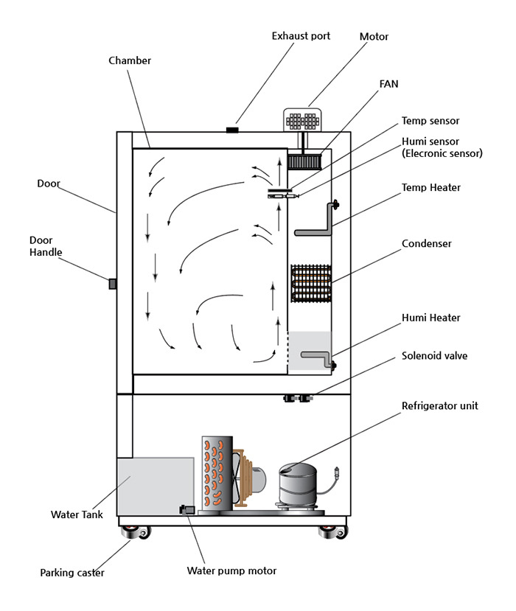

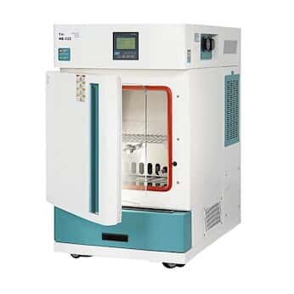

Introduction
Temperature humidity chamber (climate testing)
Scenario
Main frequency of the condenser fan is around 300 Hz.
Other components generate noise in wide frequency range.
Goal: Design acoustic filters to protect graduate students
Exhaust vent
Motor
Chamber
Centrifugal fan
Temperature sensor
Humidity sensor
Door
Temperature heater
Door handle
Air circulation
Evaporator
Humidity heater
Solenoid valve
Air Outlet
Acoustic filter
Compressor
Air Inlet
Water tank
Noise generating component
Parking caster
Water pump
Condenser and fan
Temperature humidity chamber and graduate student
Schematic of temperature humidity chamber

Slide 3
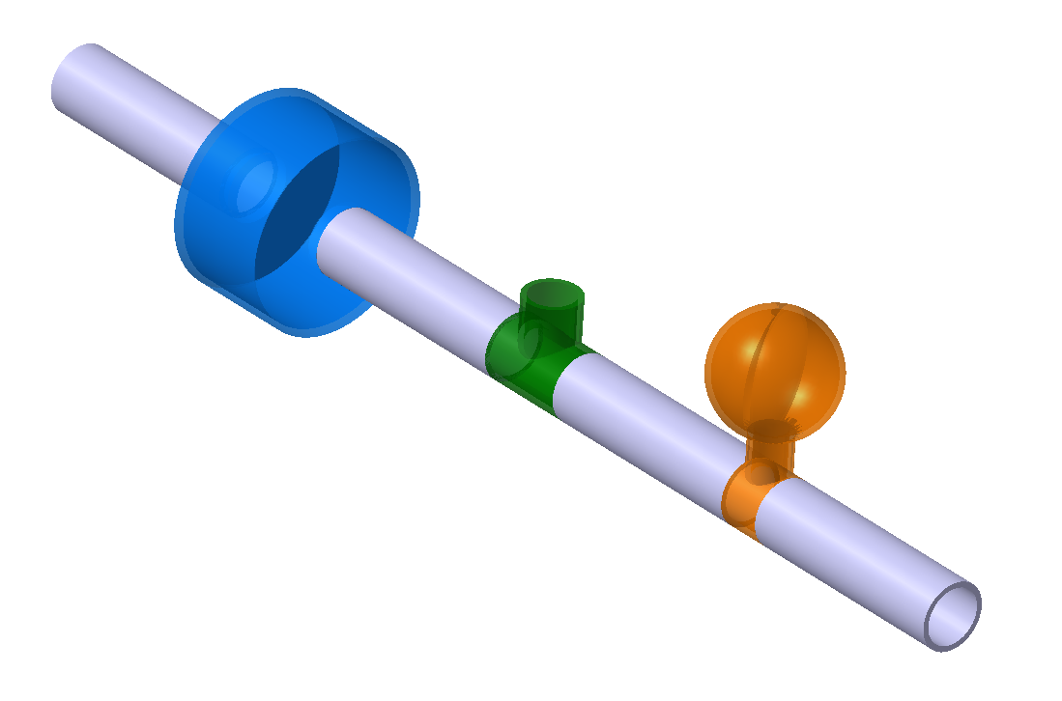
Acoustic filter system
Design objective
Design each acoustic filter element to reduce sound transmission in all given frequency range (0 ~ 2000 Hz).
Find the proper order of elements
Main target frequency: 300 Hz
Assumption
Medium is air.
There is no dissipation.
Outlet is anechoically terminated.
Plane wave is propagating through the system.
Mean flow velocity of air is near zero (M =0).
Given:
d = 25 mm
l = 100 mm
0 < f < 2000 Hz
4 Straight pipes
Upstream
l
Medium: air
d
Expansion chamber
Orifice
Helmholtz resonator
Downstream
Acoustic filter system

Slide 4
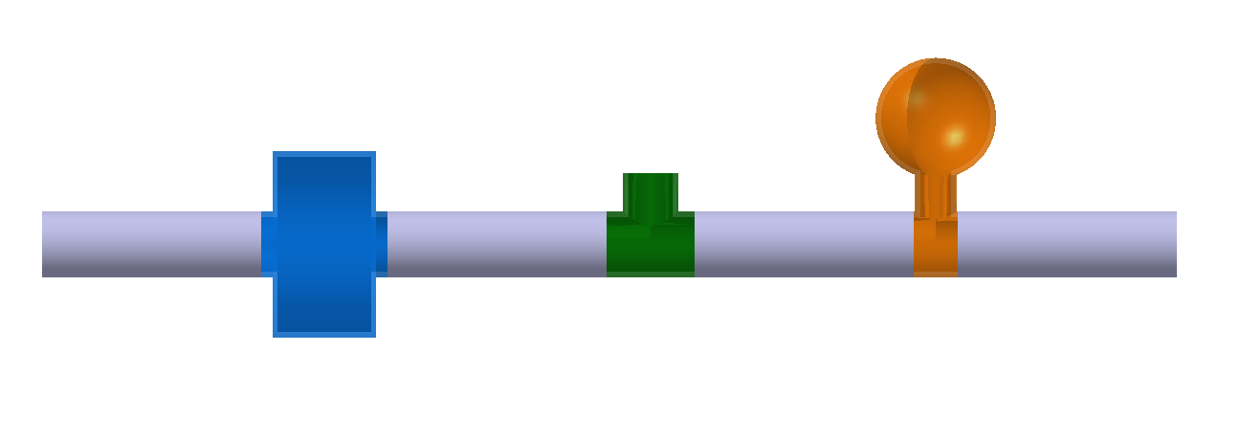


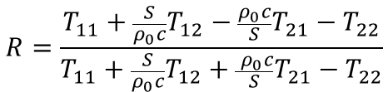



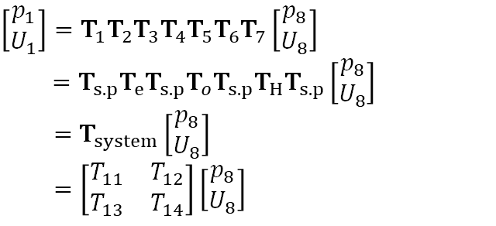









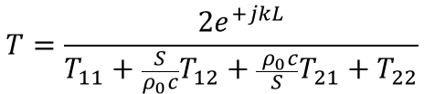




Design of acoustic filter: Transfer matrix approach
Abbreviation
s: straight pipe
e.c: expansion chamber
o: orifice
H: Helmholtz resonator
Helmholtz resonator
Expansion chamber
$$\left[T_{1,3,5,7}\right]=[T_{s.p}]$$
Orifice
$$\left[T_{2}\right]=\left[T_{e}\right]$$
x=0
Anechoic termination
$$\left[T_{4}\right]=\left[T_{o}\right]$$
R
x=L
Te^{-jkL}
$$\left[T_{6}\right]=\left[T_{H}\right]$$
1
x
①
②
③
④
⑤
⑥
⑦
⑧
Nomenclature
$$p_{1}, u_{1}$$
$${[T_{1}]}_{2×2}$$
$$\left[T_{2}\right]$$
$$[T_{3}]$$
$$\left[T_{4}\right]$$
$$[T_{5}]$$
$$\left[T_{6}\right]$$
$$[T_{7}]$$
$$p_{8}, u_{8}$$
ρ₀: Density of air
c: Speed of sound
k: Wavenumber
[T]: Transfer matrix
T_{ij}: Element of transfer matrix
p: Pressure
u: Particle velocity
S: Cross-section area
U: Volume velocity (= Su)
R: Reflection coefficient
R_{П}: Power reflection coefficient
T: Transmission coefficient
T_{П} : Power transmission coefficient
TL: Transmission loss
$$\left[\begin{matrix}p_{1} \\ U_{1}\end{matrix}\right]=T_{1}T_{2}T_{3}T_{4}T_{5}T_{6}T_{7}\left[\begin{matrix}p_{8} \\ U_{8}\end{matrix}\right]$$
$$=T_{s.p}T_{e}T_{s.p}T_{o}T_{s.p}T_{H}T_{s.p}\left[\begin{matrix}p_{8} \\ U_{8}\end{matrix}\right]$$
$=$ $T_{system}\left[\begin{matrix}p_{8} \\ U_{8}\end{matrix}\right]$
$=\left[\begin{matrix}T_{11} & T_{12} \\ T_{13} & T_{14}\end{matrix}\right]\left[\begin{matrix}p_{8} \\ U_{8}\end{matrix}\right]$
$$R=\frac{T_{11}+\frac{S}{ρ_{0}c}T_{12}−\frac{ρ_{0}c}{S}T_{21}−T_{22}}{T_{11}+\frac{S}{ρ_{0}c}T_{12}+\frac{{ ρ}_{0}c}{S}T_{21}−T_{22}}$$
$$T=\frac{2e^{+jkL}}{T_{11}+\frac{S}{ρ_{0}c}T_{12}+\frac{{ ρ}_{0}c}{S}T_{21}+T_{22}}$$
… (1)
$$R_{Π}={\left|R\right|}^{2}$$
$$T_{Π}={\left|T\right|}^{2}$$
$$\left[\begin{matrix}1+R \\ \frac{S}{ρ_{0}c}\left(1−R\right)\end{matrix}\right]=\left[\begin{matrix}T_{11} & T_{12} \\ T_{13} & T_{14}\end{matrix}\right]\left[\begin{matrix}Te^{−jkL} \\ \frac{S}{ρ_{0}c}Te^{−jkL}\end{matrix}\right]$$
… (2)
$$TL=10\log_{10}\frac{1}{T_{Π}}$$
$$R_{Π}+T_{Π}=1$$

Slide 5



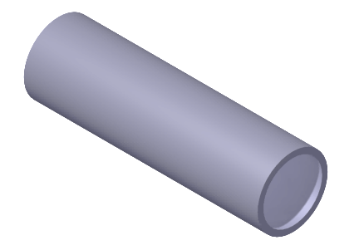
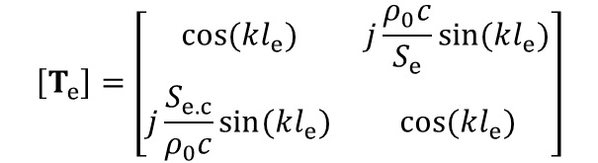

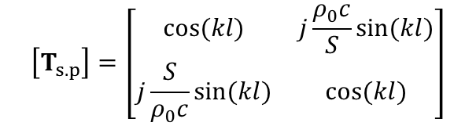

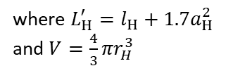



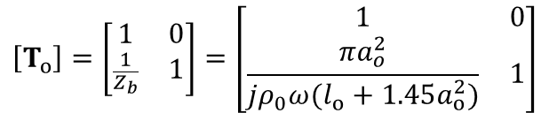
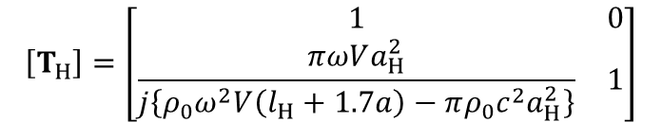
Modeling of transfer matrix of each element
Low-pass
High-pass
|T|²
|T|²
Expansion chamber
l_{e.c}
Orifice
a_{o}
f
f
$$\left[T_{e}\right]=\left[\begin{matrix}cos⁡(kl_{e}) & j\frac{ρ_{0}c}{S_{e}}sin⁡(kl_{e}) \\ j\frac{S_{e.c}}{ρ_{0}c}sin⁡(kl_{e}) & cos⁡(kl_{e})\end{matrix}\right]$$
$$\left[T_{o}\right]=\left[\begin{matrix}1 & 0 \\ \frac{1}{Z_{b}} & 1\end{matrix}\right]=\left[\begin{matrix}1 & 0 \\ \frac{πa_{o}^{2}}{jρ_{0}ω(l_{o}+1.45a_{o}^{2})} & 1\end{matrix}\right]$$
l_{o}
d_{e}
0
where $S_{e}=\frac{π}{4}d_{e}^{2}$
$$Z_{b}=\frac{ρ_{0}ck^{2}}{4π}+j\frac{ρ_{0}ωL_{o}′}{πa_{o}^{2}}$$
where $L_{o}^{′}=l_{o}+1.45a_{o}^{2}$
*Unflanged end-correction
Band-stop
|T|²
Helmholtz resonator
r_{H}
Straight pipe
f
$$\left[T_{s.p}\right]=\left[\begin{matrix}cos⁡(kl) & j\frac{ρ_{0}c}{S}sin⁡(kl) \\ j\frac{S}{ρ_{0}c}sin⁡(kl) & cos⁡(kl)\end{matrix}\right]$$
d
l
$$\left[T_{H}\right]=\left[\begin{matrix}1 & 0 \\ \frac{πωVa_{H}^{2}}{j\left\{ρ_{0}ω^{2}V\left(l_{H}+1.7a\right)−πρ_{0}c^{2}a_{H}^{2}\right\}} & 1\end{matrix}\right]$$
a_{H}
l_{H}
0
where $S=\frac{π}{4}d^{2}$
$$Z_{b}=R_{m}+j\left(\frac{ρ_{0}ωL_{H}′}{πa_{H}^{2}}−\frac{ρ_{0}c}{ωV}\right)$$
where $L_{H}^{′}=l_{H}+1.7a_{H}^{2}$
and $V=\frac{4}{3}πr_{H}^{3}$
Assumption
No mean air flow through expansion and contraction (All elements)
No viscous & thermal losses and no radiation to infinity (Helmholtz)
*Flanged end-correction

Slide 6

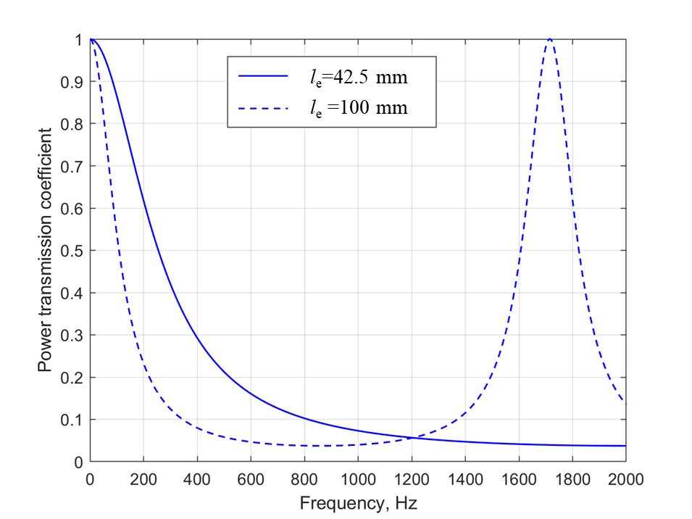


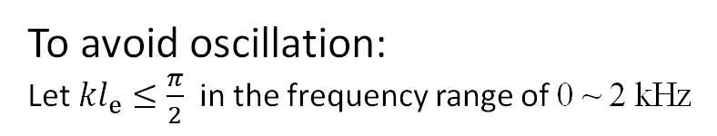
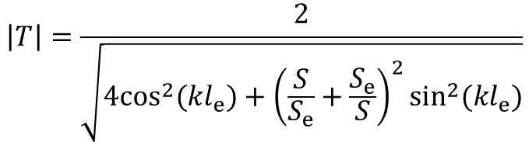
Parameter tunning (1): Expansion chamber
l_{e}
Sub-objective: a low-pass filter with wide stop band and high attenuation rate
$$\left|T\right|=\frac{2}{\sqrt{4\cos^{2}(kl_{e})+{\left(\frac{S}{S_{e}}+\frac{S_{e}}{S}\right)}^{2}\sin^{2}(kl_{e})}}$$
R
T
d_{e}
1
Expansion chamber and parameters
To avoid oscillation:
Let ${kl}_{e}≤\frac{π}{2}$ in the frequency range of 0 ~ 2 kHz
→$l_{e}≤42.5 mm$
For higher attenuation, we also need larger diameter:
→$l_{e}=42.5 mm, d_{e}=80 mm$

Slide 7

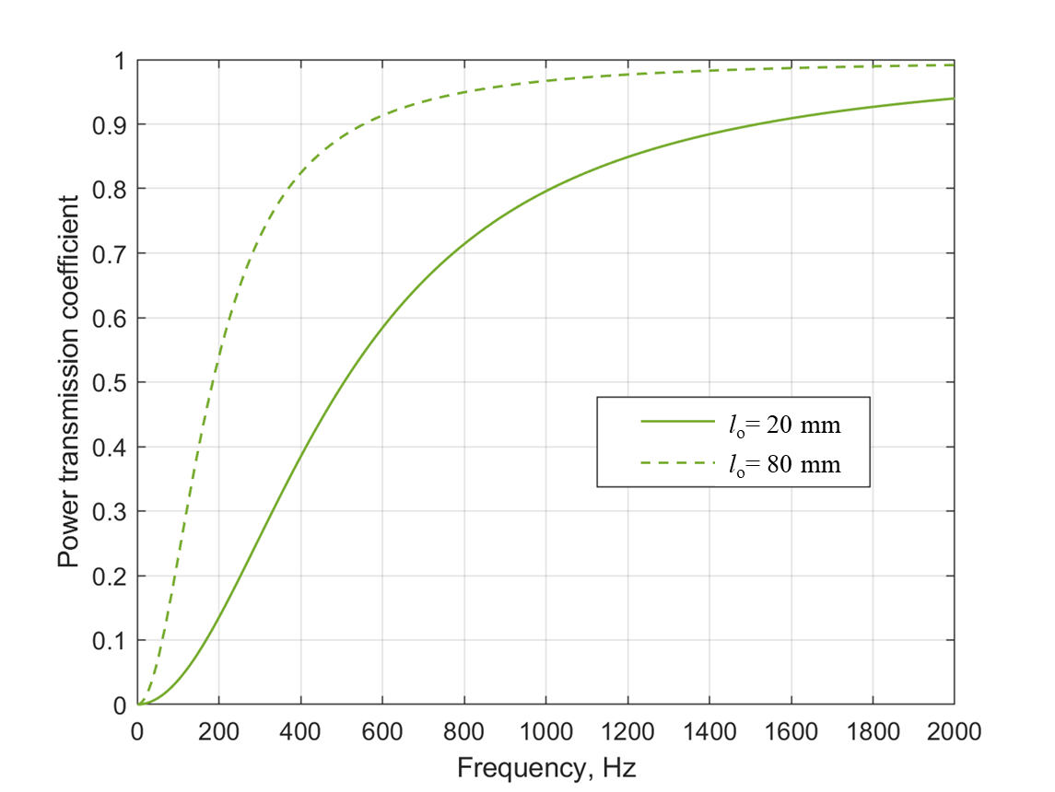




Parameter tunning (2): Orifice
Sub-objective: a high-pass filter with wide stop band and high attenuation rate
a_{o}
l_{o}
$$\left|T\right|=\frac{2}{\sqrt{4+{\left(\frac{πa_{o}^{2}c}{S(l_{0}+1.45a_{o})ω}\right)}^{2}}}$$
R
T
1
$$f_{c}=\frac{a_{o}^{2}c}{4S (l_{o}+1.45a_{o})}$$
Orifice and parameters
For a wider stop band, we need larger diameter and smaller length:
$$a_{o}=10 mm, l_{o}=20 mm$$
→$f_{c}≅500 Hz$

Slide 8
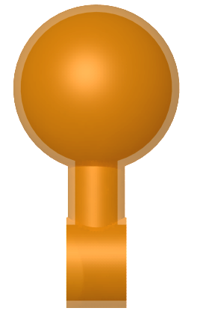
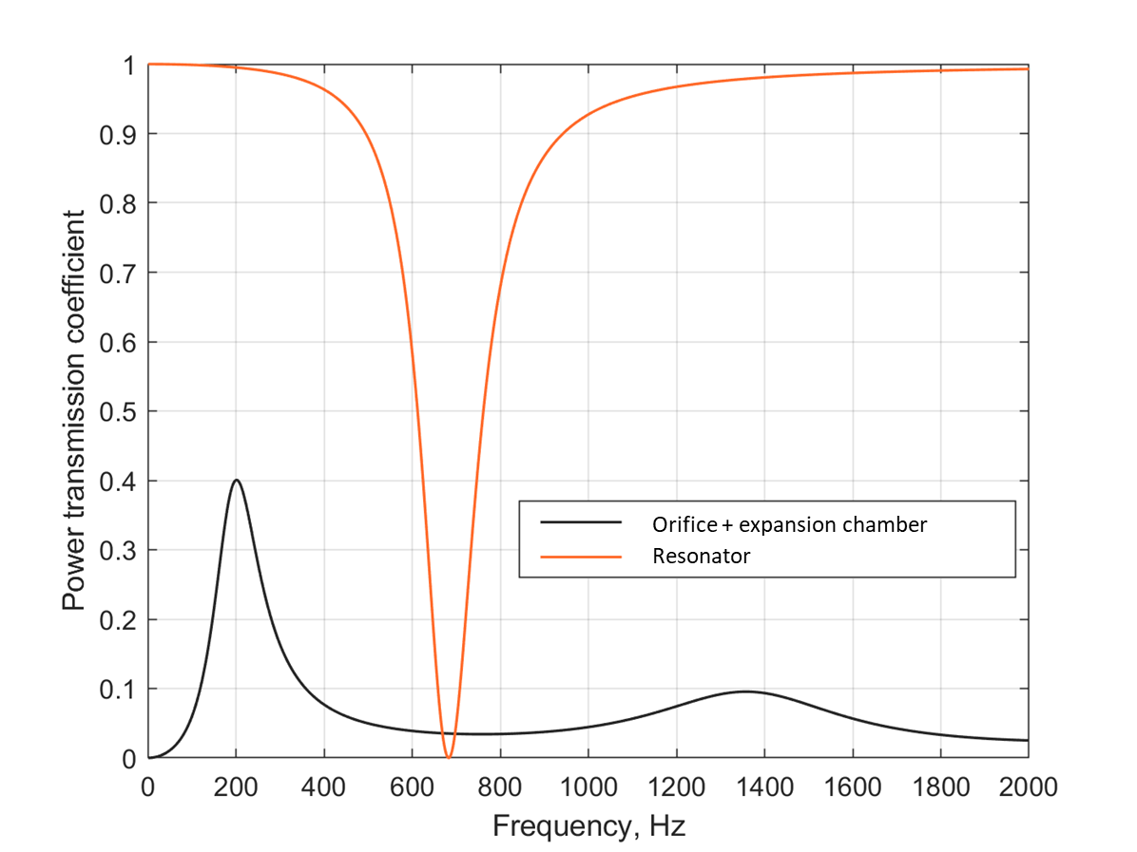
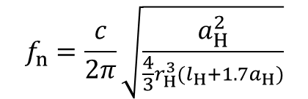

Parameter tunning (3): Helmholtz resonator
Sub-objective: a band-stop filter to attenuate the bump caused by transition regions of high and low pass filters
r_{H}
a_{H}
l_{H}
$$f_{n}=\frac{c}{2π}\sqrt{\frac{a_{H}^{2}}{\frac{4}{3}r_{H}^{3}(l_{H}+1.7a_{H})}}$$
R
T
1
Helmholtz resonator and parameters
The f_{n} is finally tuned to be around 300 Hz:
→$l_{H}=60 mm, a_{H}=7 mm, r_{H}=25 mm$

Slide 9
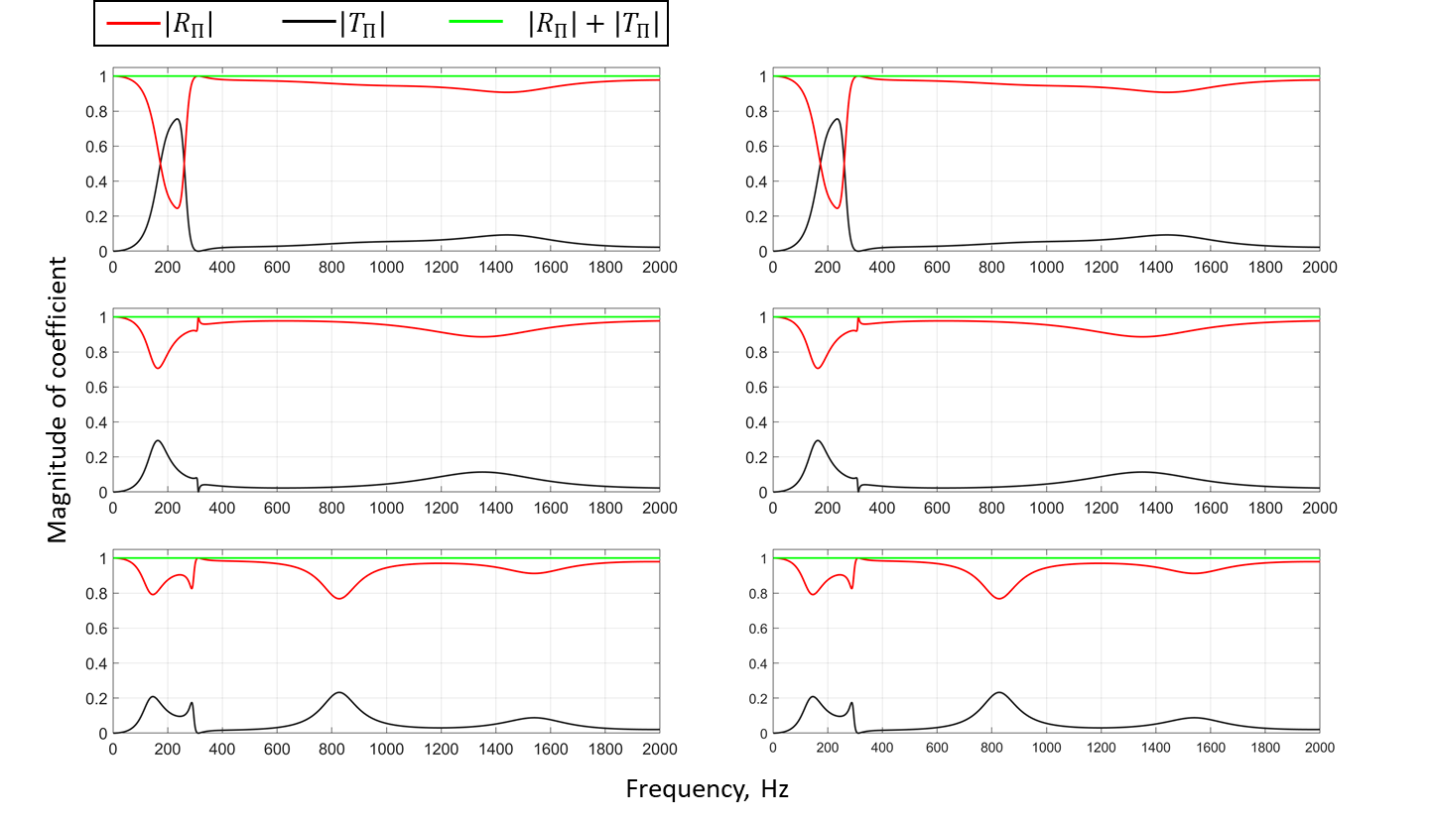
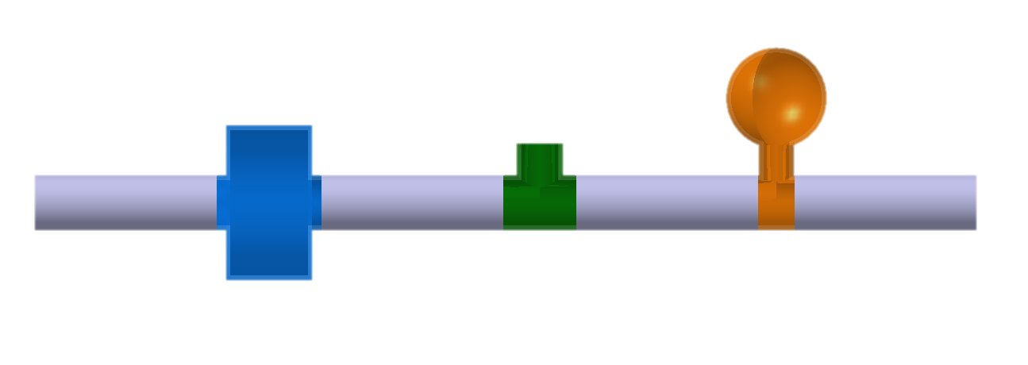
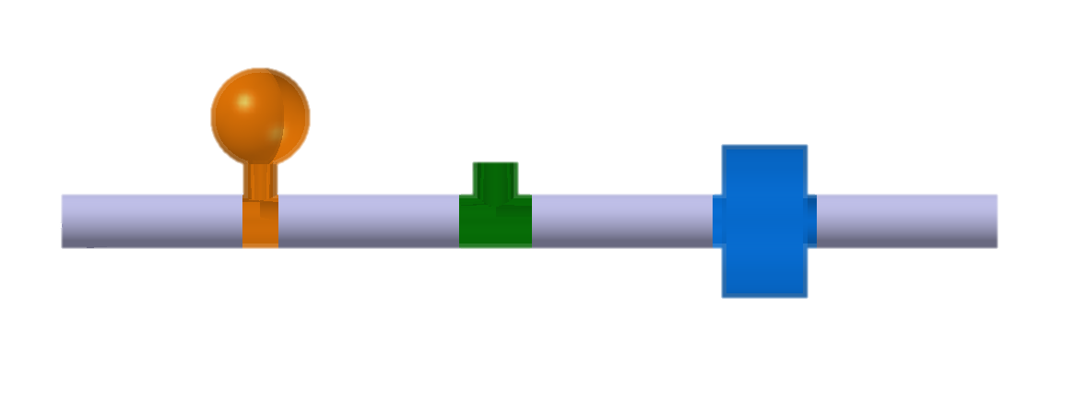
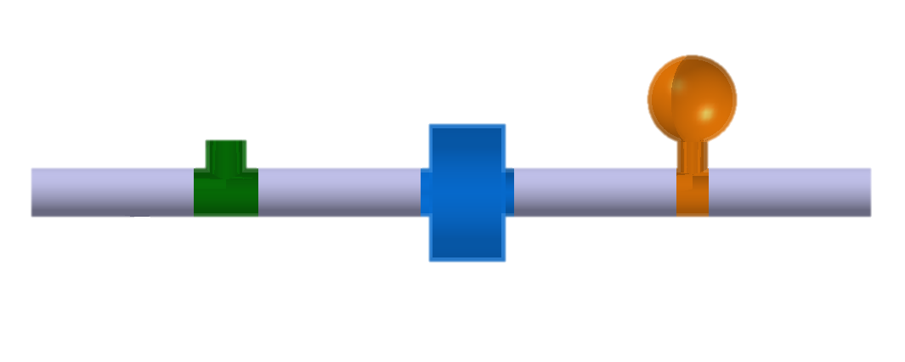
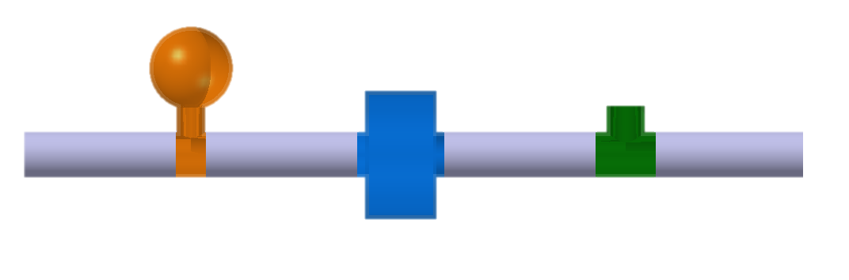
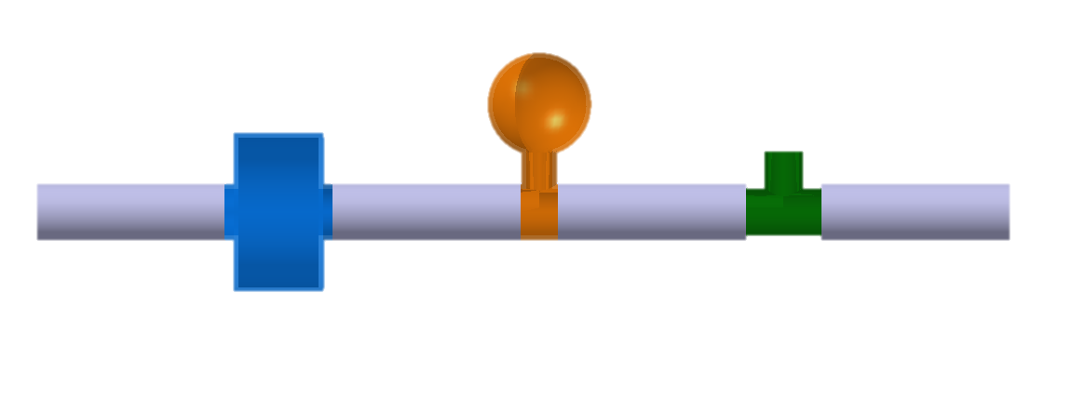
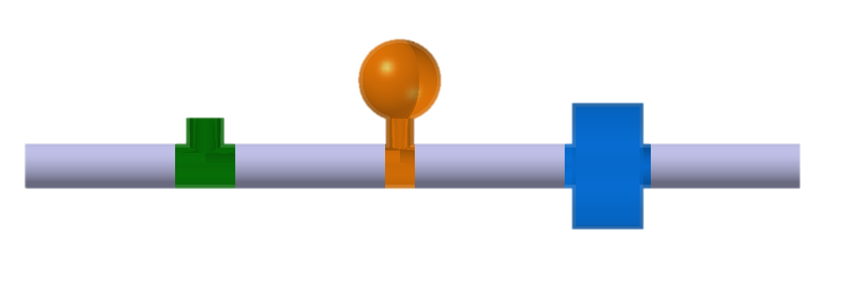
Effect of order of elements
We see 3 'sets' of results
Why is this?
A filter operates the same 'forwards' and 'backwards'
e.g.,
=
E
O
H
H
O
E
=
O
E
H
H
E
O
performs equivalently to
=
E
H
O
O
H
E

Slide 10
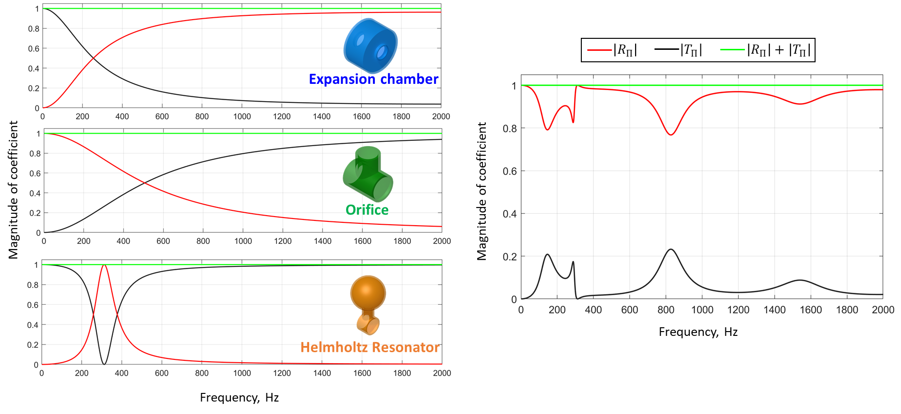
Performance of entire system (E-H-O order)
Expansion chamber
Helmholtz Resonator
Orifice

Slide 11
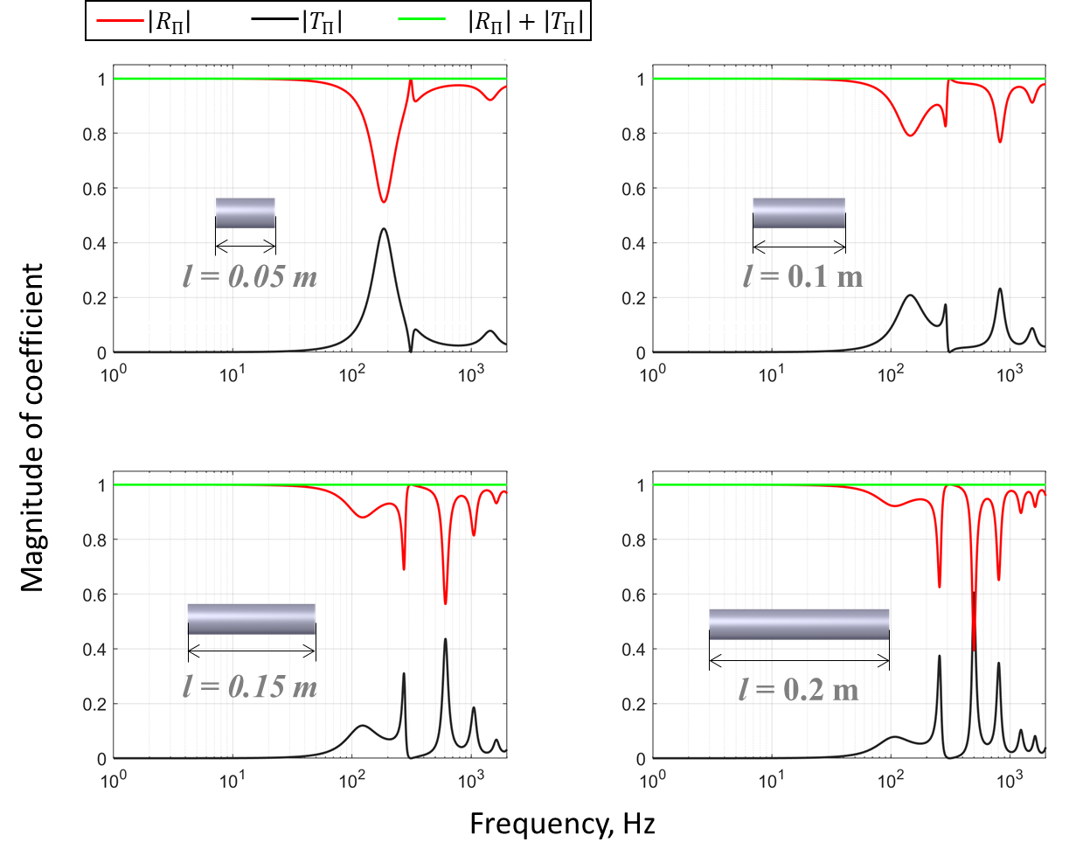
Effect of the total length of the system
Increasing the total length increases the number of peaks we see in the transmission coefficient

Slide 12

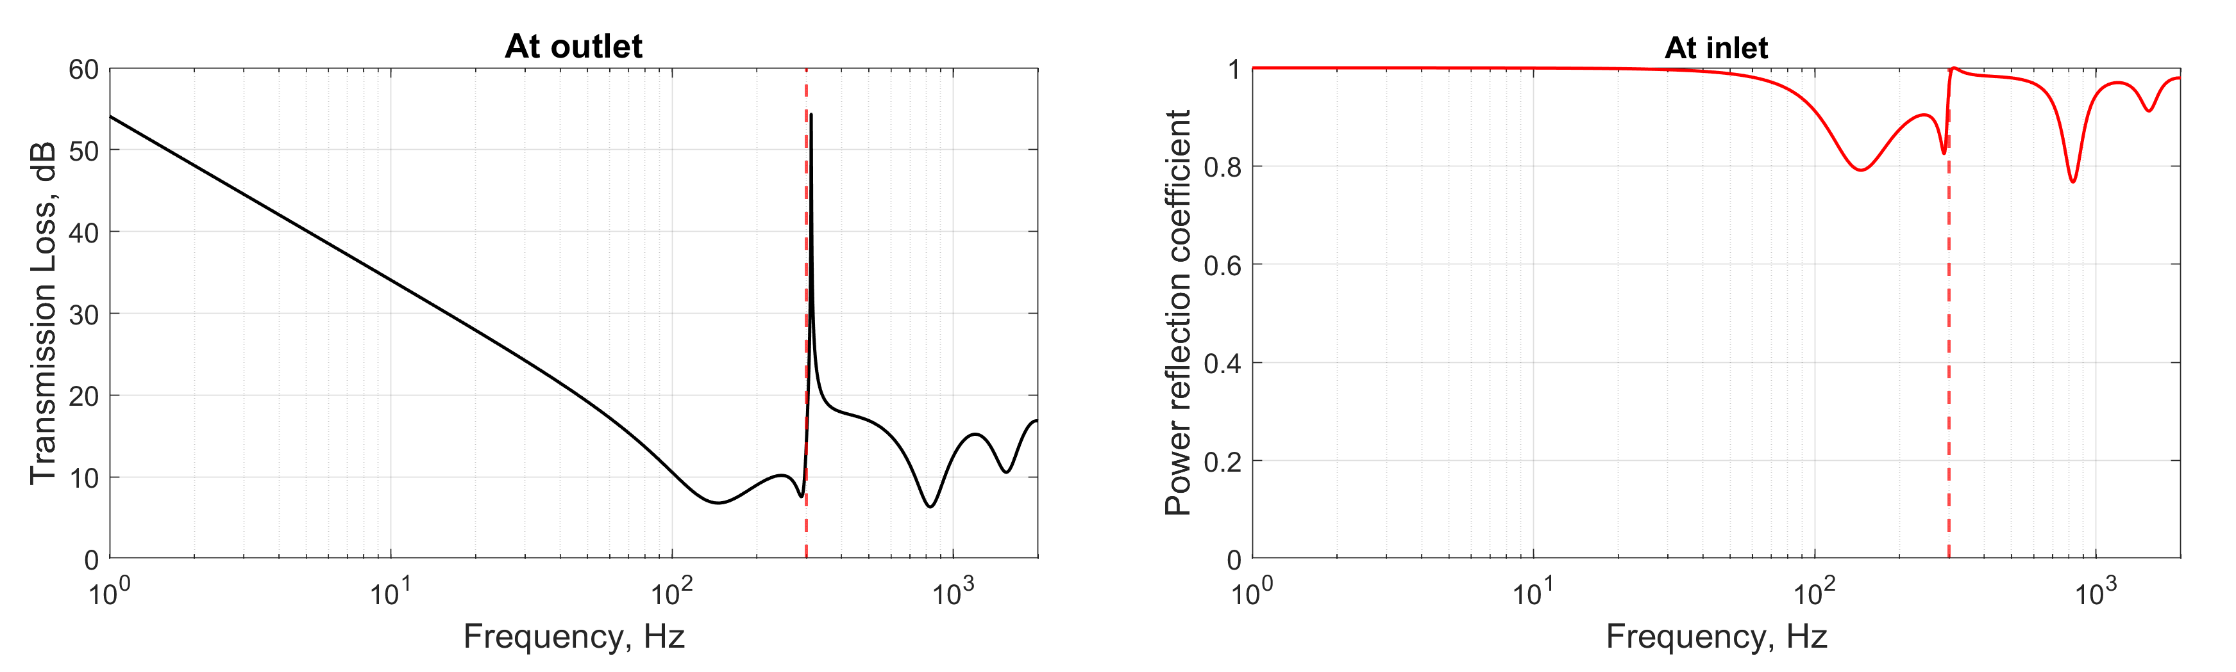


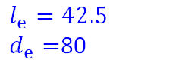

Summary & Discussion
Objective: Design an acoustic filter to reduce noise from a temperature humidity chamber
Problematic 300 Hz noise produced by condenser fan
Also looking to attenuate the entire frequency range
Our Filter:
Results:
$$l_{H}=60$$
$$a_{H}=7$$
$$r_{H}=25$$
$$l_{o}=20$$
$a_{o}=$10
$$l_{e}=42.5$$
$d_{e}=$80
$$d=25$$
$$l=100$$
Expansion chamber
Helmholtz Resonator
Orifice
Unit: mm
300 Hz
300 Hz

Slide 13
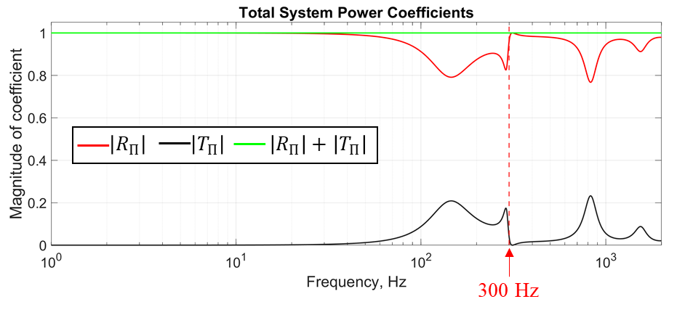
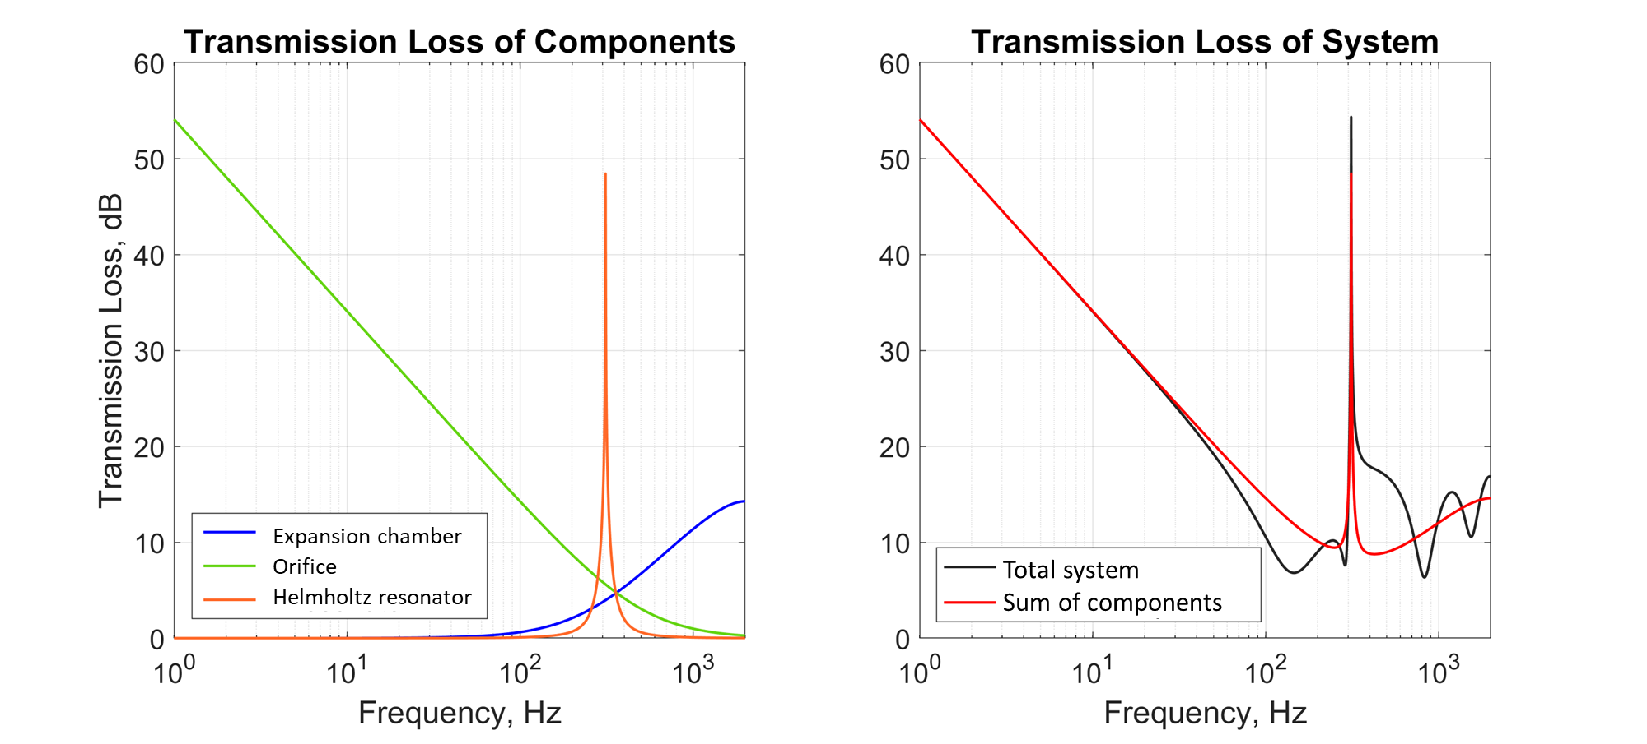
Summary & Discussion, cont.
Verification of Results by Summation of Power Coefficients to Unity:
The Power Transmission and Power Reflection Coefficients do sum to 1 at all frequencies
Transmission Loss of Individual Components vs. Whole System:
The sum of the TL of components is NOT equal to the total TL.

Slide 14
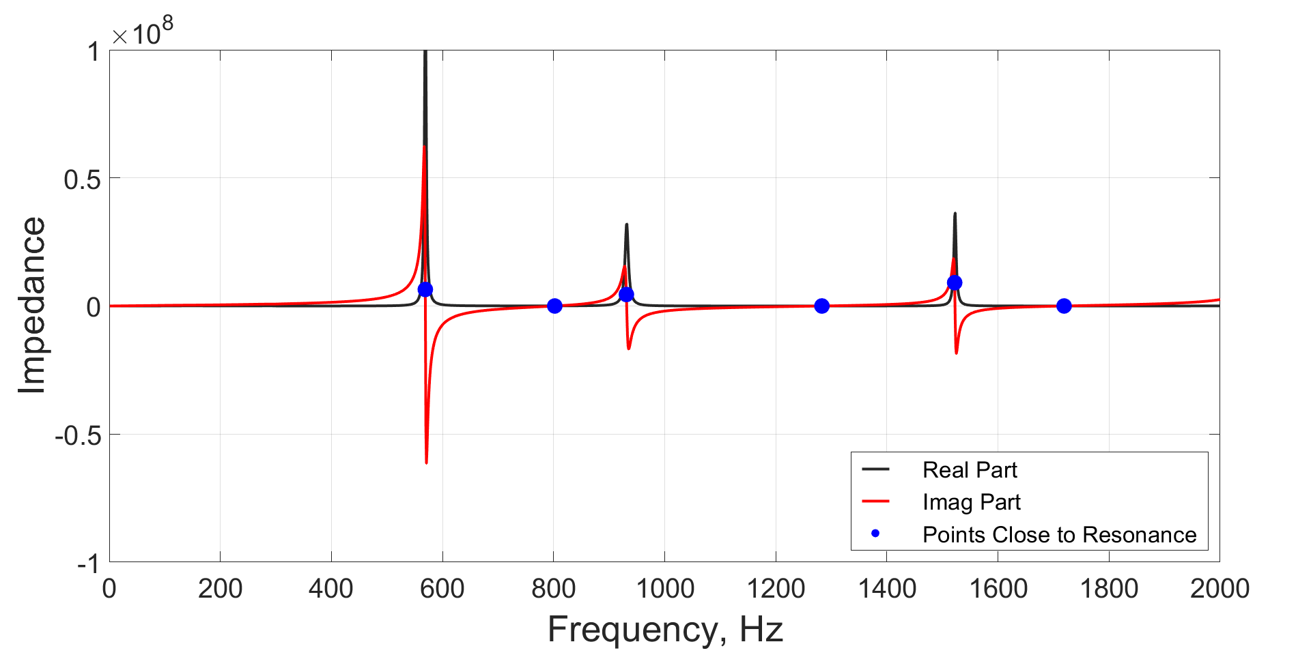
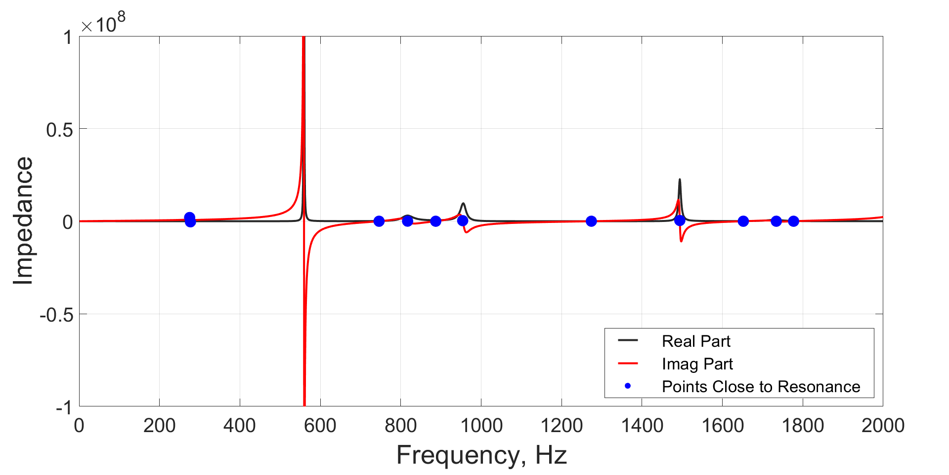


Summary & Discussion, cont.
Input Impedance:
Resonance greatly influenced by length of the system
The resonance points can be associated with the length of the expansion chamber
The real impedance implies an energy loss in the system, which in this case does not represent dissipation, but rather energy leaving the system at the outlet.
l_{e} = 42.5 mm (design)
l_{e} = 200 mm
Expansion chamber
Expansion chamber

Slide 15
Thank you for your attention!

